Slide 1



React Server Component

Slide 2

OUTLINE
1
Overview
2
Explain RSC & SSR & RCC
3
Features
4
Demo
5
Wrapping up

Slide 3



1
Overview

Slide 4

Why Server Component ?
Common Problems with React Applications:
User Experience: We build software products for our users and customers. The user experience of the application matters if we want the app to be successful.
Maintainability: The project code must be well maintained over the years, across several development teams.
Performance Cost: The application shouldn't be sluggish and our design approach must not slow things down.
Notes:
User Experience: Chúng tôi xây dựng các sản phẩm phần mềm cho người dùng và khách hàng của mình. Trải nghiệm người dùng của ứng dụng rất quan trọng nếu chúng ta muốn ứng dụng thành công.
Maintainability: Mã dự án phải được duy trì tốt qua nhiều năm, qua nhiều nhóm phát triển.
Performance Cost: Ứng dụng không được chậm và phương pháp thiết kế của chúng tôi không được làm mọi thứ chậm lại.

Slide 5
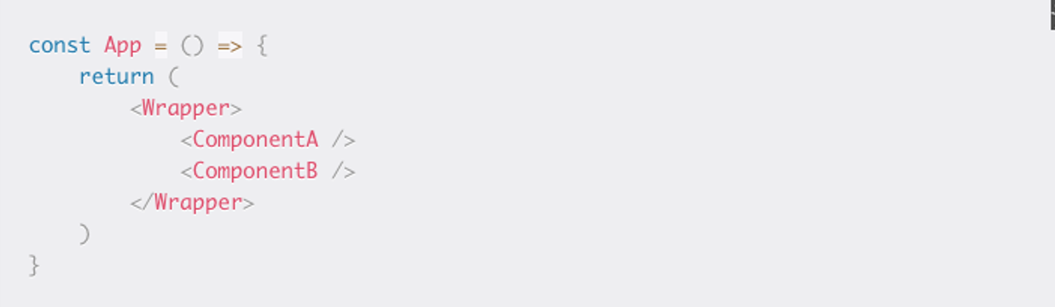
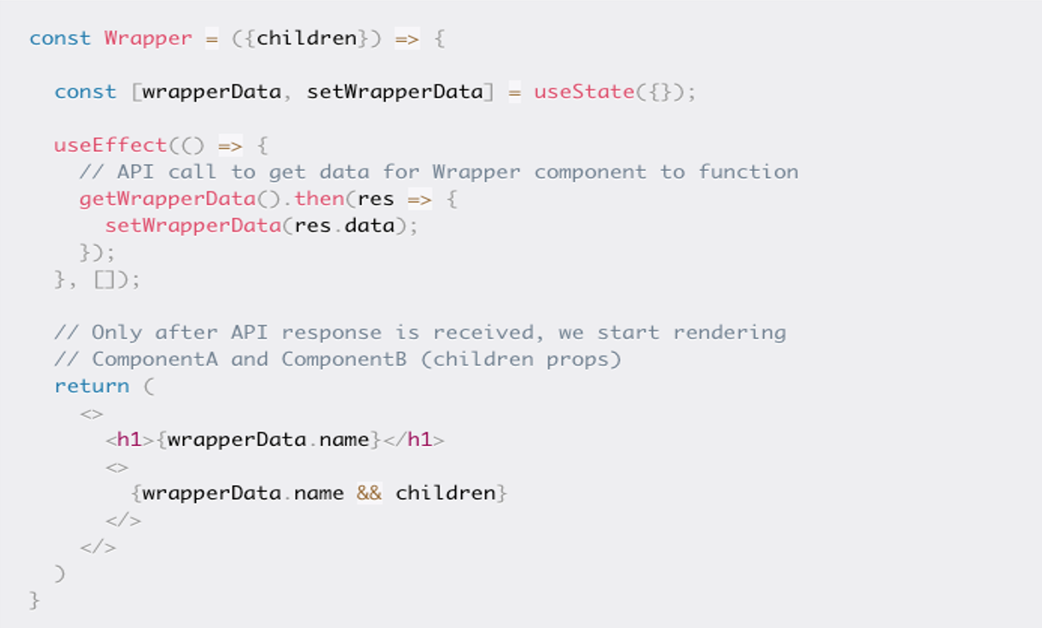
Waterfalls networking
Example:

Slide 6
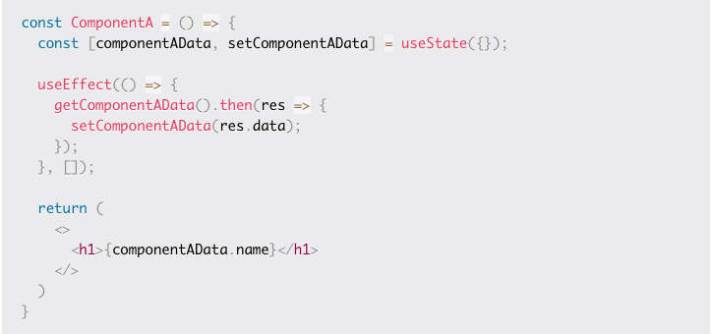
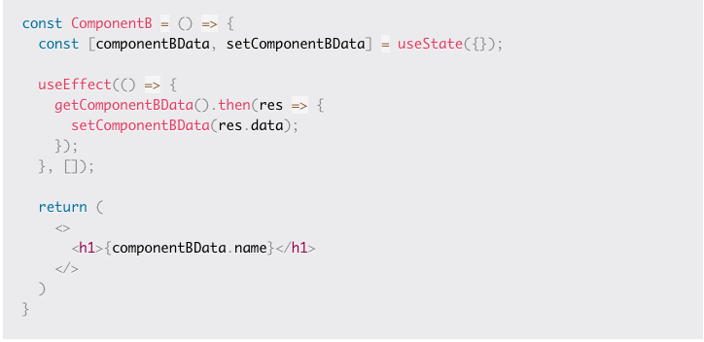
Waterfalls networking
Example:

Slide 7
Why Server Component ?
Assume the time it takes to get the response for API calls fired from each component is as follows:
<Wrapper /> takes 1 sec to get the response
<ComponentB /> takes 2 sec to get the response
<ComponentA /> takes 3 sec to get the response
The problem:
1. Wrapper is visible to the user after 1 sec.
2. Then ComponentB appears after 2 seconds.
3. After 3 seconds, ComponentA appears. But ComponentA enters the view by pushing ComponentB down. As if ComponentA just popped out of nowhere. This is not a great user experience.
Notes:
Waterfall problem
Another problem is, child components (ComponentA and ComponentB) are not even rendered until the Wrapper component get the response from the API call it made (refer to image 2), which results in a waterfall. Sequential data fetching always introduces waterfalls.
In our example, only after getting the response to the API call in the Wrapper component are the other two components rendered.
How can we solve this problem? Well, we can do a single fetch to get all the data in the App component, and then pass the necessary data to each component. Something like this:

Slide 8
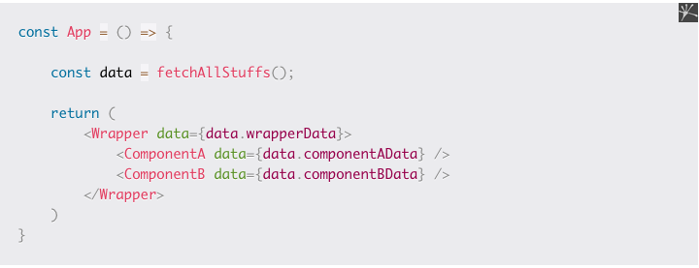
Why Server Component ?
Maintainability Issues
- For example, if we remove ComponentA in the future, we also want to remove componentAData from the API response, since we dont wan't to deal with data not used by the component. After all, if there's no ComponentA, then there's no need of ComponentAData.
Notes:
For example, if we remove ComponentA in the future, we also want to remove componentAData from the API response, since we dont wan't to deal with data not used by the component. After all, if there's no ComponentA, then there's no need of ComponentAData.
=> Maintainability Issues

Slide 9

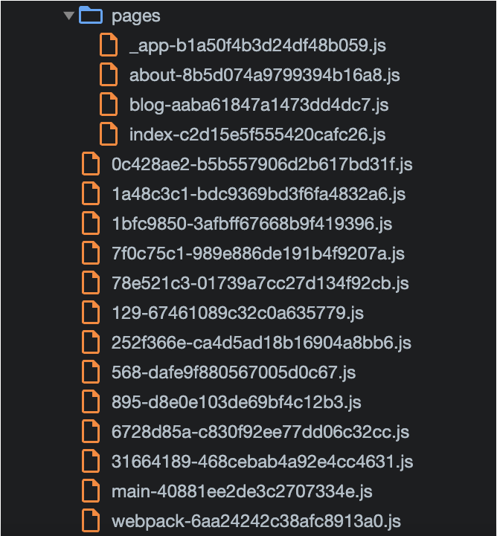
Why Server Component ?
Performance Costs
- Traditionally, React components are client side JavaScript functions.
- When we load the application on the client, the components get downloaded on the client and React performs what's necessary to render them for you.

Slide 10


Explain…
The solution is
Server Component
RSC is a component render from the server

Slide 11

2
Explain
SSR & RSC & RCC

Slide 12
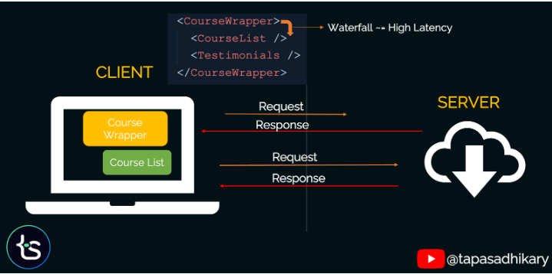
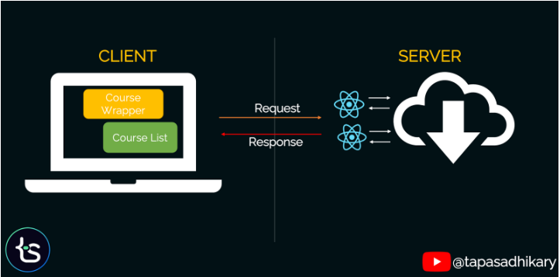
Server Components vs Client Components

Slide 13
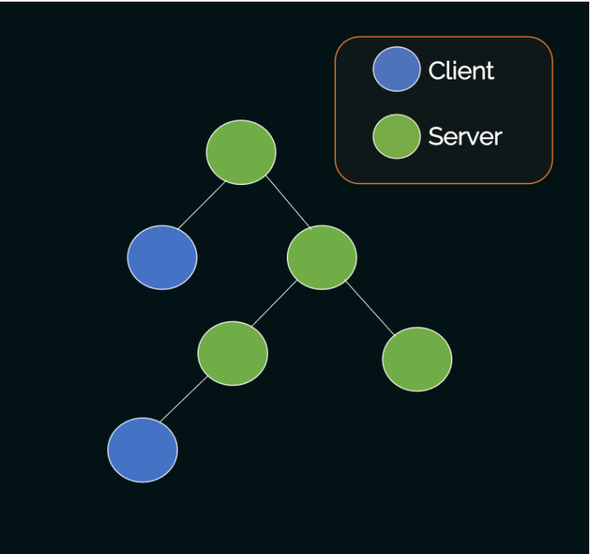
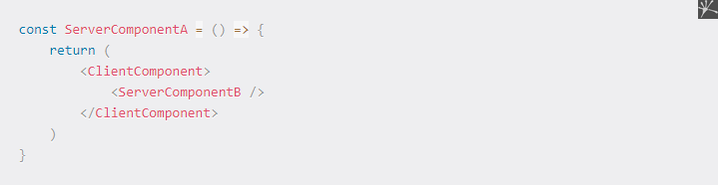
How to Use Client and Server Components Together
- You can import Client Components inside Server Components.
- You cannot import Server Components inside Client Components.
- You can pass a Server Component as a child prop to a Client Component inside Server Component.

Slide 14
Aren't RSCs the Same as Server Side Rendering (SSR)?
RSC: The components stay on the server and have access to the server infrastructure without making any network roundtrips.
SSR: Send the raw HTML from the server to the client, then all the client side JavaScript gets downloaded. React starts the Hydration process to transform the HTML to an interactive React component. In SSR the component doesn't stay on the server.
Summary: SSR is useful for faster loading of the initial page of your application. You can use SSR and RSCs together in your application without any problems.

Slide 15

3
Features

Slide 16

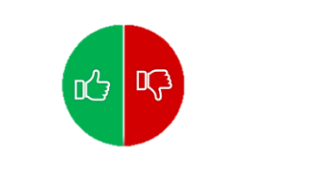

3.1 Do and Don’t of React Server Component
Do
Don’t
Use async/await with data sources: db, files
Cannot use hooks provided by React like useState, useReducer, useEffect
Native elements like div, span, or Client Components
Cannot use browser API's like Local Storage
Cannot use any utility functions that depend on browser only API's or custom hooks that depend on state or effects.

Slide 17
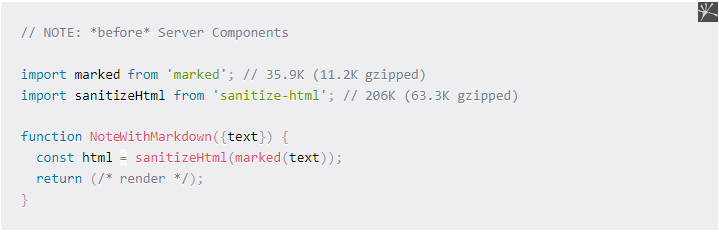
3.2 Zero bundle size components
Using libraries is helpful to developers, but it increases the bundle size and can hurt application performance.
Server Components allow developers to render static content on the server. You can freely use third-party packages in Server Components while incurring zero impact on bundle size.
If we render the above example as a Server Component, we can use the exact same code for our feature but avoid sending it to the client – a code savings of over 240K (uncompressed).

Slide 18
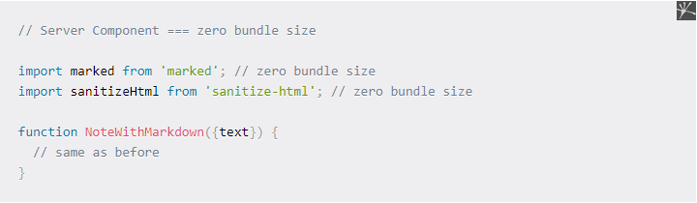
3.2 Zero bundle size components
In short, if you are using any third party library inside Server Component, the library is not included in the client side bundle. This reduces the JavaScript bundle size.

Slide 19

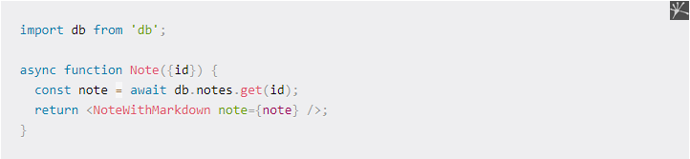
3.3 Complete access to backend
Server Components can take advantage of direct backend access to use databases, internal (micro) services, and other backend-only data sources.

Slide 20
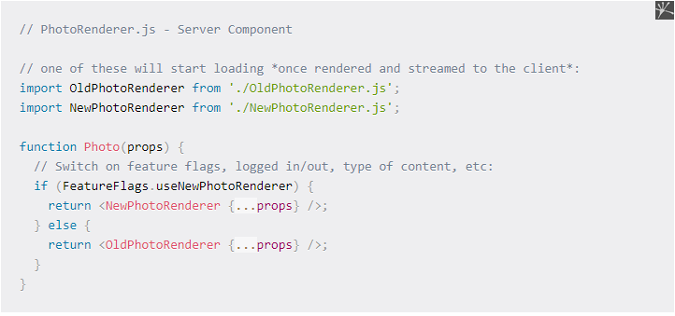
3.4 Automatic code spliting
Server Components treat all imports of Client Components as potential code-split points. Don’t send unnecessary component.
The component will be loaded lazily (meaning, it won't be sent to the client immediately). So, only the JavaScript related to the component that is visible to the user is needed.

Slide 21
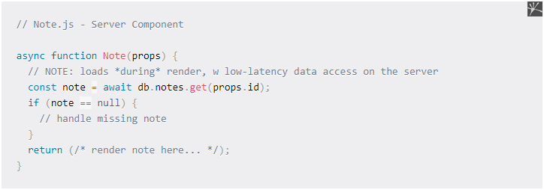
3.5 No more waterfall
As discussed earlier, sequential data fetching introduces waterfalls. We wanted to find a way to avoid sequential round trip delay from client to server. (That is, we have to wait until one request finishes, and the request can take some time to fulfill since it has to travel from client to the server.)

Slide 22
4
Demo…

Slide 23

5
Summary:
React Server Components have backend access without any network roundtrips.
We can avoid network waterfalls using React Server Components
React server components support automatic code splitting and improve your app's performance with zero bundle size.
As these components are on the server side, they do not have access to client side event handlers, state, and effects. This means you can not use any event handlers, or React hooks like useState, useReducer, and useEffect.
A React server component can import and render a client component but the reverse is not true. But you can pass a server component as props to a client component.
Wrapping up

Slide 24
Thanks for watching!

